Slide 1

Finding Best Places For Chinese Restaurants in Pune
Ganisha Bhawsar
27th April 2020

Slide 2

Pune as a Food Hub
Being one of the major IT cities of India, Pune hosts a huge number of international firms with many employees and student recruits from all over the country.
Pune has a huge demand of all kinds of outside food. Apart from the traditional Maharashtrian, Gujarati and North Karnataka cuisine, there’s a good demand for international delicacies.

Slide 3

Business Problem & Target Audience
By using data science methods and machine learning methods such as clustering, we aim to answer: In Pune, if an entrepreneur wants to open a Chinese restaurant, where should they consider opening it?
A great opportunity for a concept Chinese restaurateur who is based in India.

Slide 4
Data Sources
Dataset containing Pune neighbourhoods via geonames.org
Getting Latitude and Longitude data of these neighbourhoods via Geocoder package
Using Foursquare API to get venue data related to these neighbourhoods

Slide 5
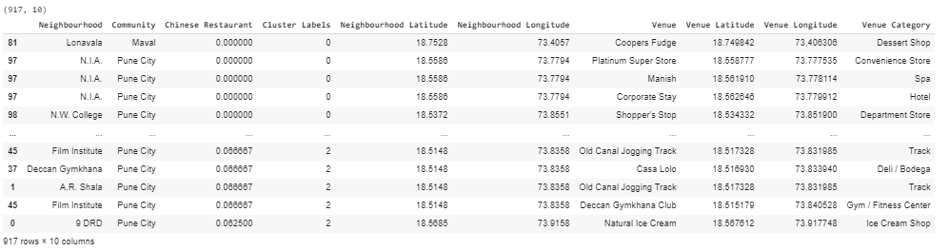
Dataset - post processing

Slide 6
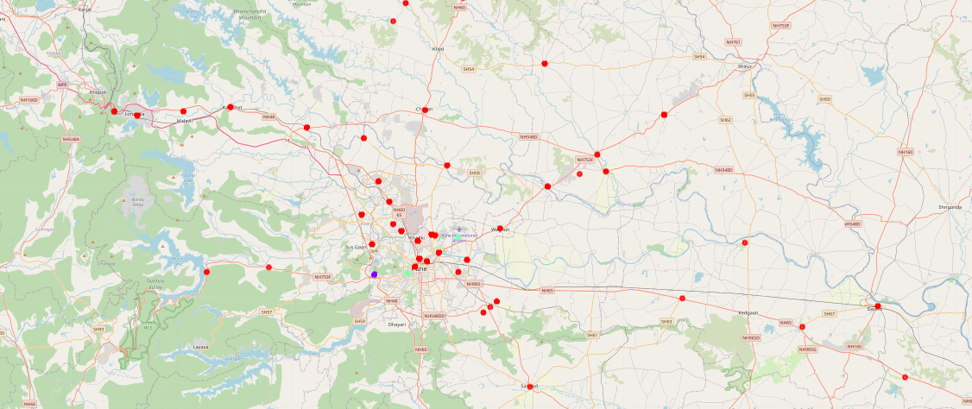
K-Means Clustering
K-means clustering algorithm identifies k number of centriods, and then allocates every data point to the nearest cluster
Clustered the neighbourhoods in Pune into 3 clusters based on their frequency of occurrence for “Chinese food”

Slide 7
Results and Visualisation
Cluster 0: Neighbourhoods with little or no Chinese restaurants
Cluster 1: Neighbourhoods with few number of Chinese restaurants
Cluster 2: Neighbourhoods with high number of Chinese restaurants

Slide 8
Conclusion
Most of Chinese restaurants are in Cluster 2 which is around Sus, Bavdhan and Armament areas
lowest (close to zero) are in Cluster 0 areas which are Lonavala, Narayan Peth, Yerwada areas.
Vadgaon Sheri, Film Institute areas have a low competition.
Recommendation - Open a Chinese restaurant in the locations with little to no competition (Cluster s 1 and 2)

Slide 9
References
List of neighbourhoods in Pune: https://download.geonames.org/export/zip/
Foursquare Developer Documentation: https://developer.foursquare.com/docs
All codes for this project can be found here: https://github.com/GB1111/Coursera_Capstone/blob/master/BestPlacesInPuneForChinese.ipynb

